Slide 1
weB PHISHING DETECTION
BY
TEAM LEADER : Vaishnavi
Team Members :
1. Lakshmi dharshini
2. Karthikeyan.V
3. Pavish Kumar

Slide 2
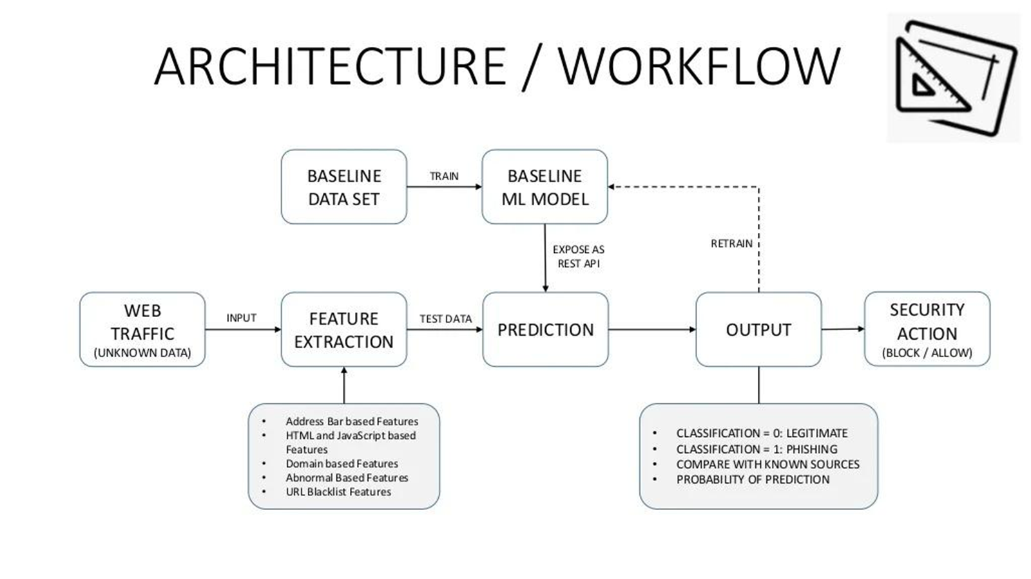
Solution architecture

Slide 3
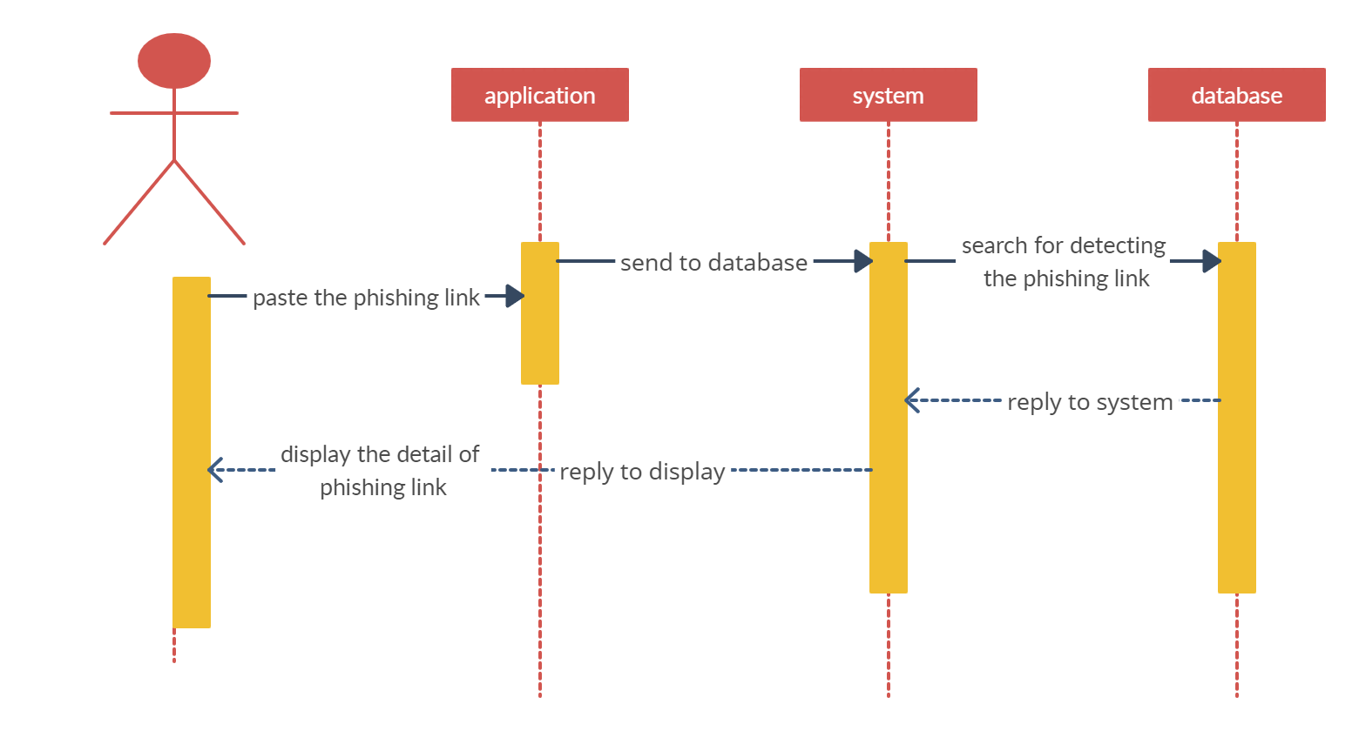
Architecture

